Slide 1
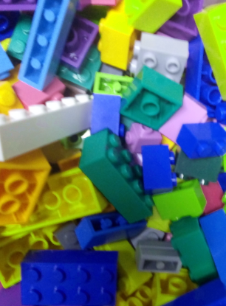
CHEM BRICKS 1.0.
This is only a draft to develop the use of “Life bricks” kits also for Organic and Inorganic Chemistry activities. Some initial materials are proposed, but the activity is not yet developed.
This card is part of the materials of the activity “LifeBricks” Materials of the activity and Didactic Guides are available for its download at: https://bit.ly/2ZksPOp

Slide 2
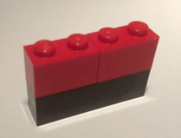
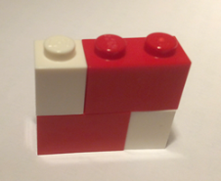
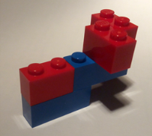
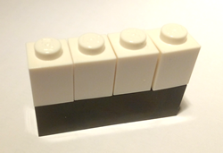
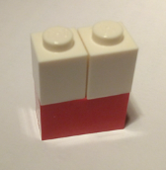
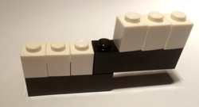
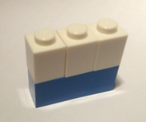
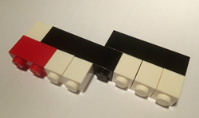
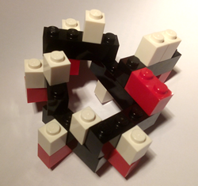
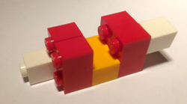
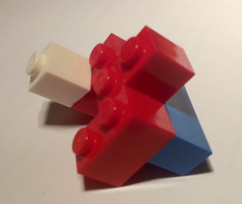
Compounds
Compounds
Not developed, just a proposal for LifeBricks 2.0
Not developed, just a proposal for LifeBricks 2.0
Carbon Dioxyde CO₂
Nitrogen Trioxide N₂O₃
Water H₂O
Ammoniac NH₃
Hydrogen Peroxyde H₂O₂
Methane CH₄
Ethane C₂H₆
Compounds
Compounds
Not developed, just a proposal for LifeBricks 2.0
Not developed, just a proposal for LifeBricks 2.0
Ethanol C₂OH₆
Sulphuric Acid H₂SO₄
Nitric Acid HNO₃
Glucose C₆H₁₂O₆

Slide 3
CHEM BRICKS
CHEM BRICKS
This card is part of the materials of the activity “ChemBricks” designed by Jordi Domènech.
Materials of the activity and Didactic Guides are available for its download at:
https://bit.ly/2ZksPOp
These materials are shared under a Creative Commons License by-nc-sa 4.0.
You are free to Share and Adapt under the following terms: Attribution, Non Commercial Uses, Share Alike. Images from Lego pieces are excluded from this general License.
This card is part of the materials of the activity “ChemBricks” designed by Jordi Domènech.
Materials of the activity and Didactic Guides are available for its download at:
https://bit.ly/2ZksPOp
These materials are shared under a Creative Commons License by-nc-sa 4.0.
You are free to Share and Adapt under the following terms: Attribution, Non Commercial Uses, Share Alike. Images from Lego pieces are excluded from this general License.
CHEM BRICKS
CHEM BRICKS
This card is part of the materials of the activity “ChemBricks” designed by Jordi Domènech.
Materials of the activity and Didactic Guides are available for its download at:
https://bit.ly/2ZksPOp
These materials are shared under a Creative Commons License by-nc-sa 4.0.
You are free to Share and Adapt under the following terms: Attribution, Non Commercial Uses, Share Alike. Images from Lego pieces are excluded from this general License.
This card is part of the materials of the activity “ChemBricks” designed by Jordi Domènech.
Materials of the activity and Didactic Guides are available for its download at:
https://bit.ly/2ZksPOp
These materials are shared under a Creative Commons License by-nc-sa 4.0.
You are free to Share and Adapt under the following terms: Attribution, Non Commercial Uses, Share Alike. Images from Lego pieces are excluded from this general License.

